Slide 1

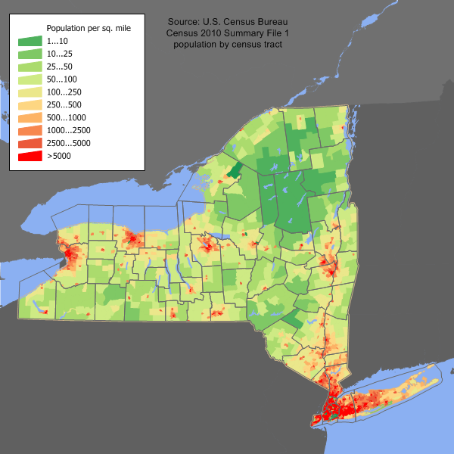
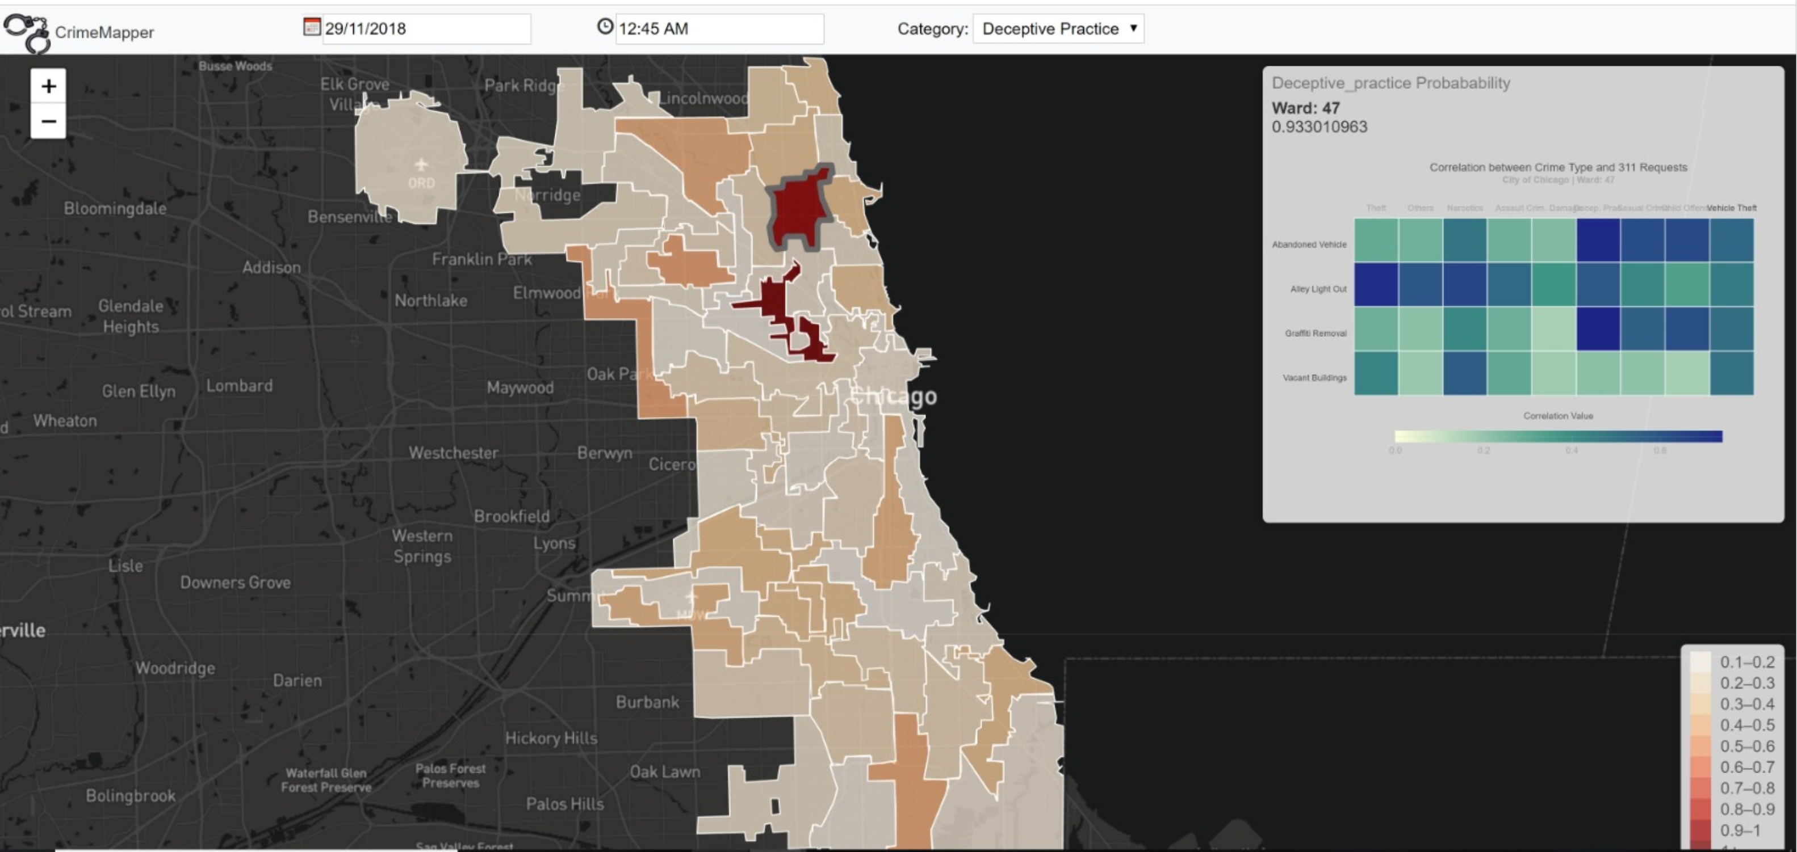
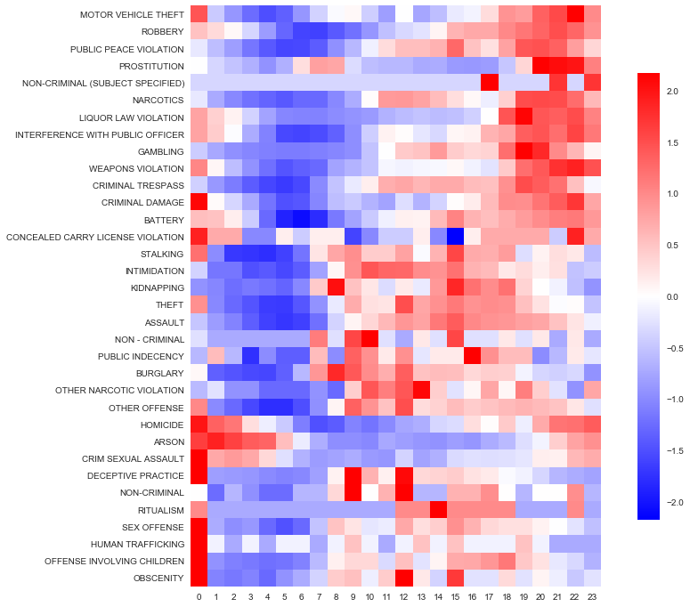
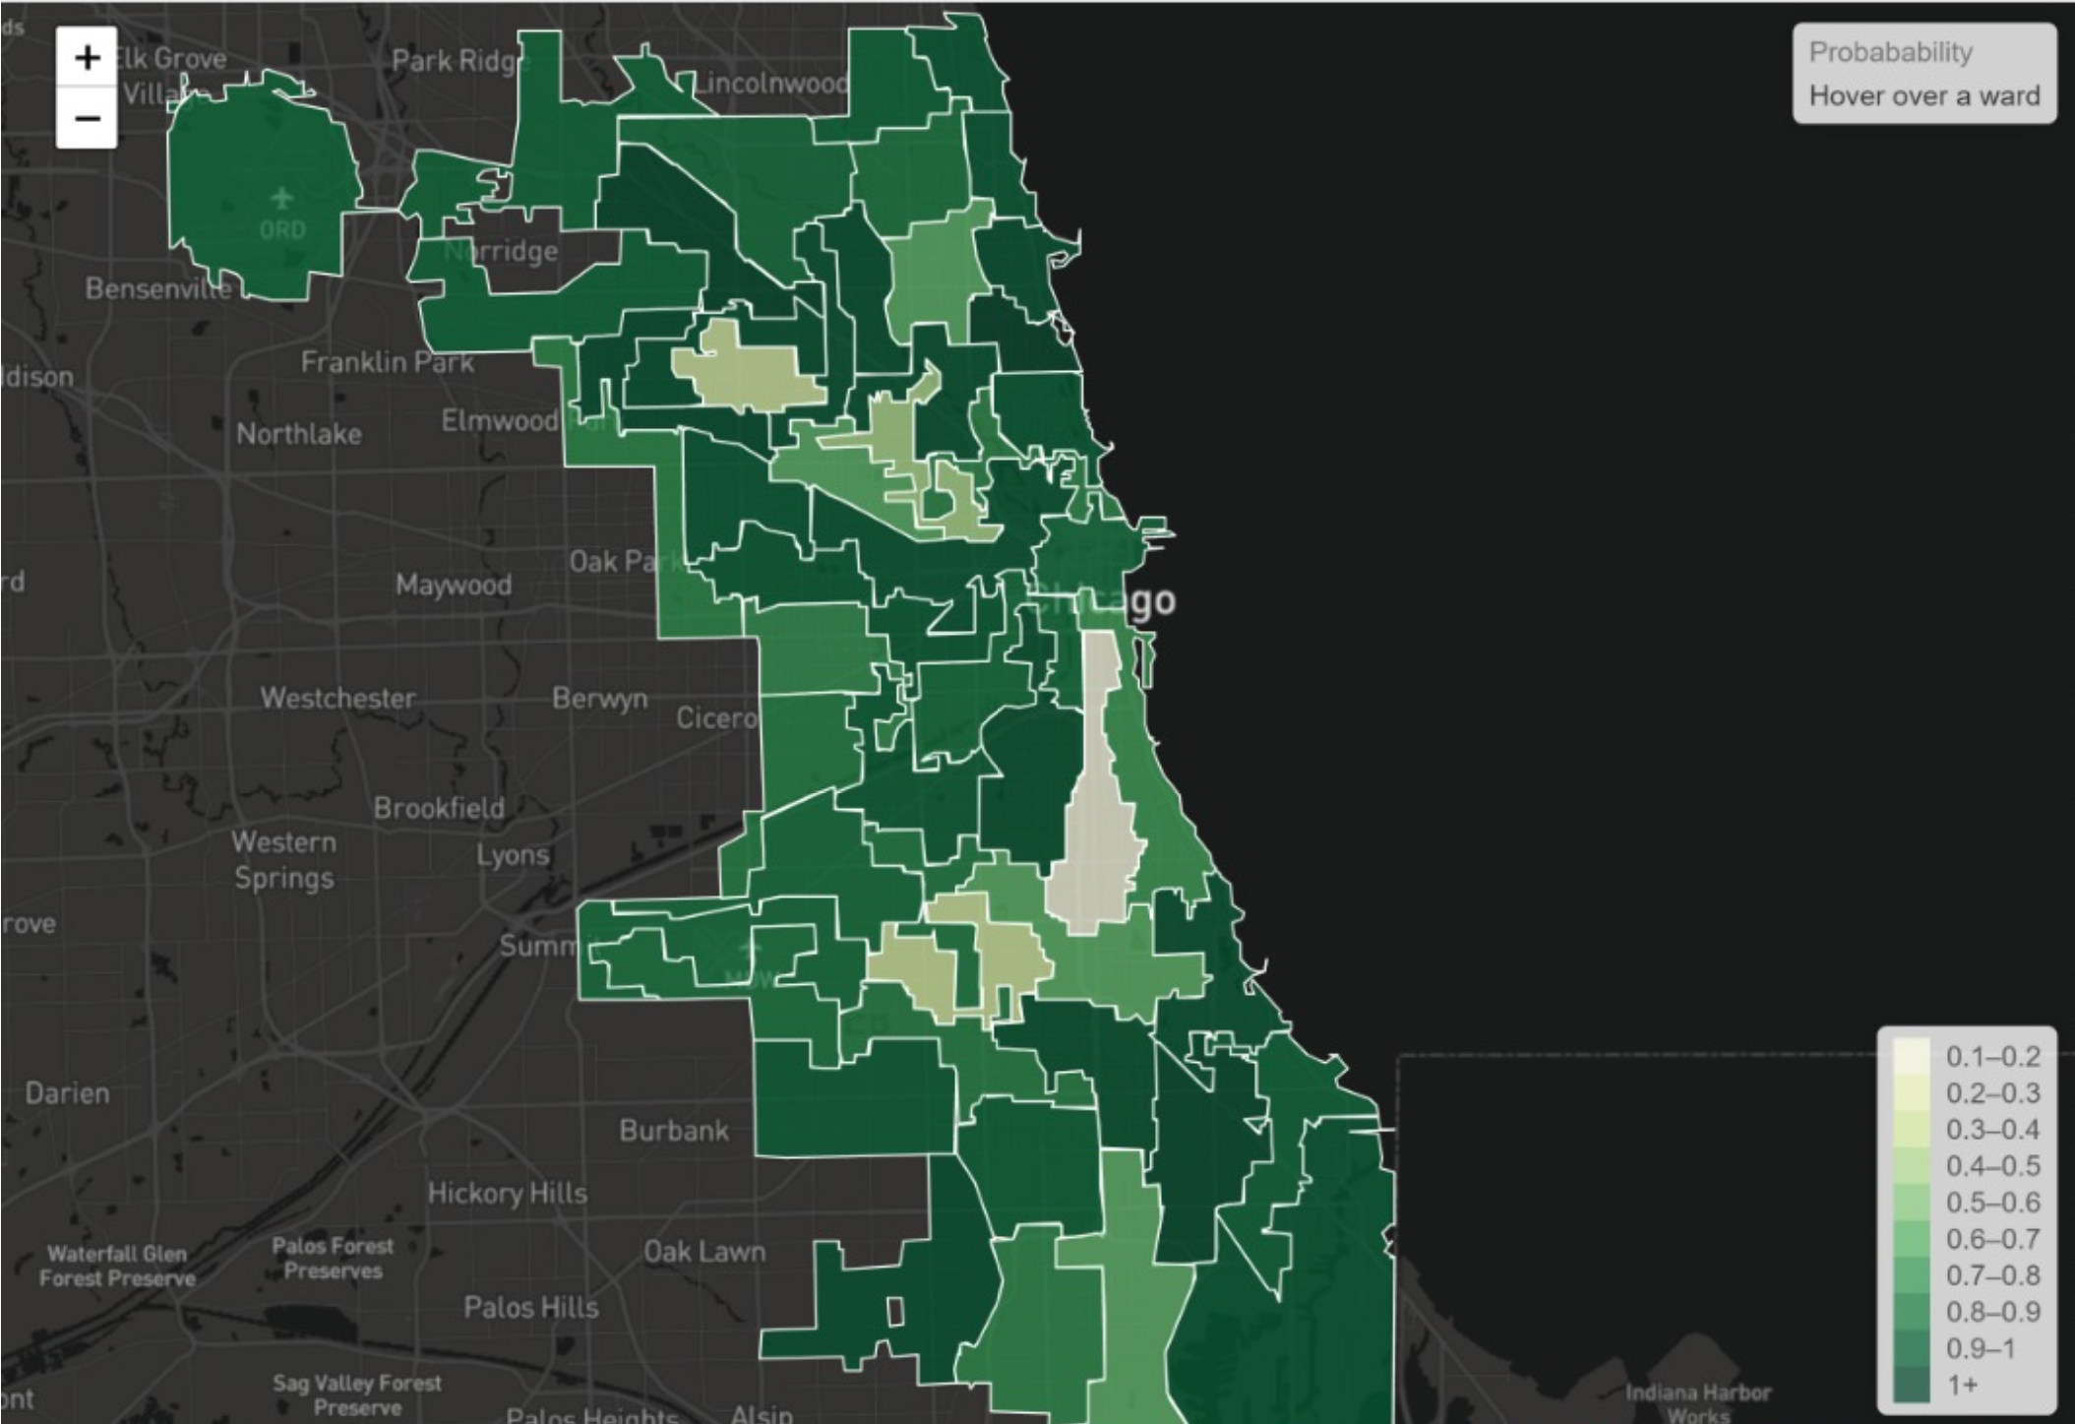
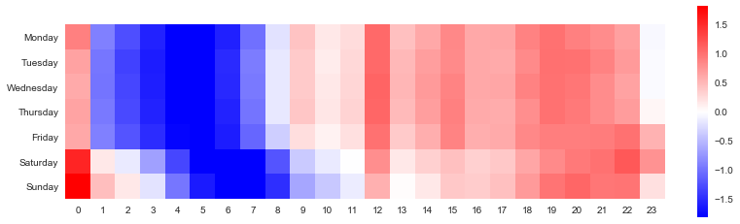
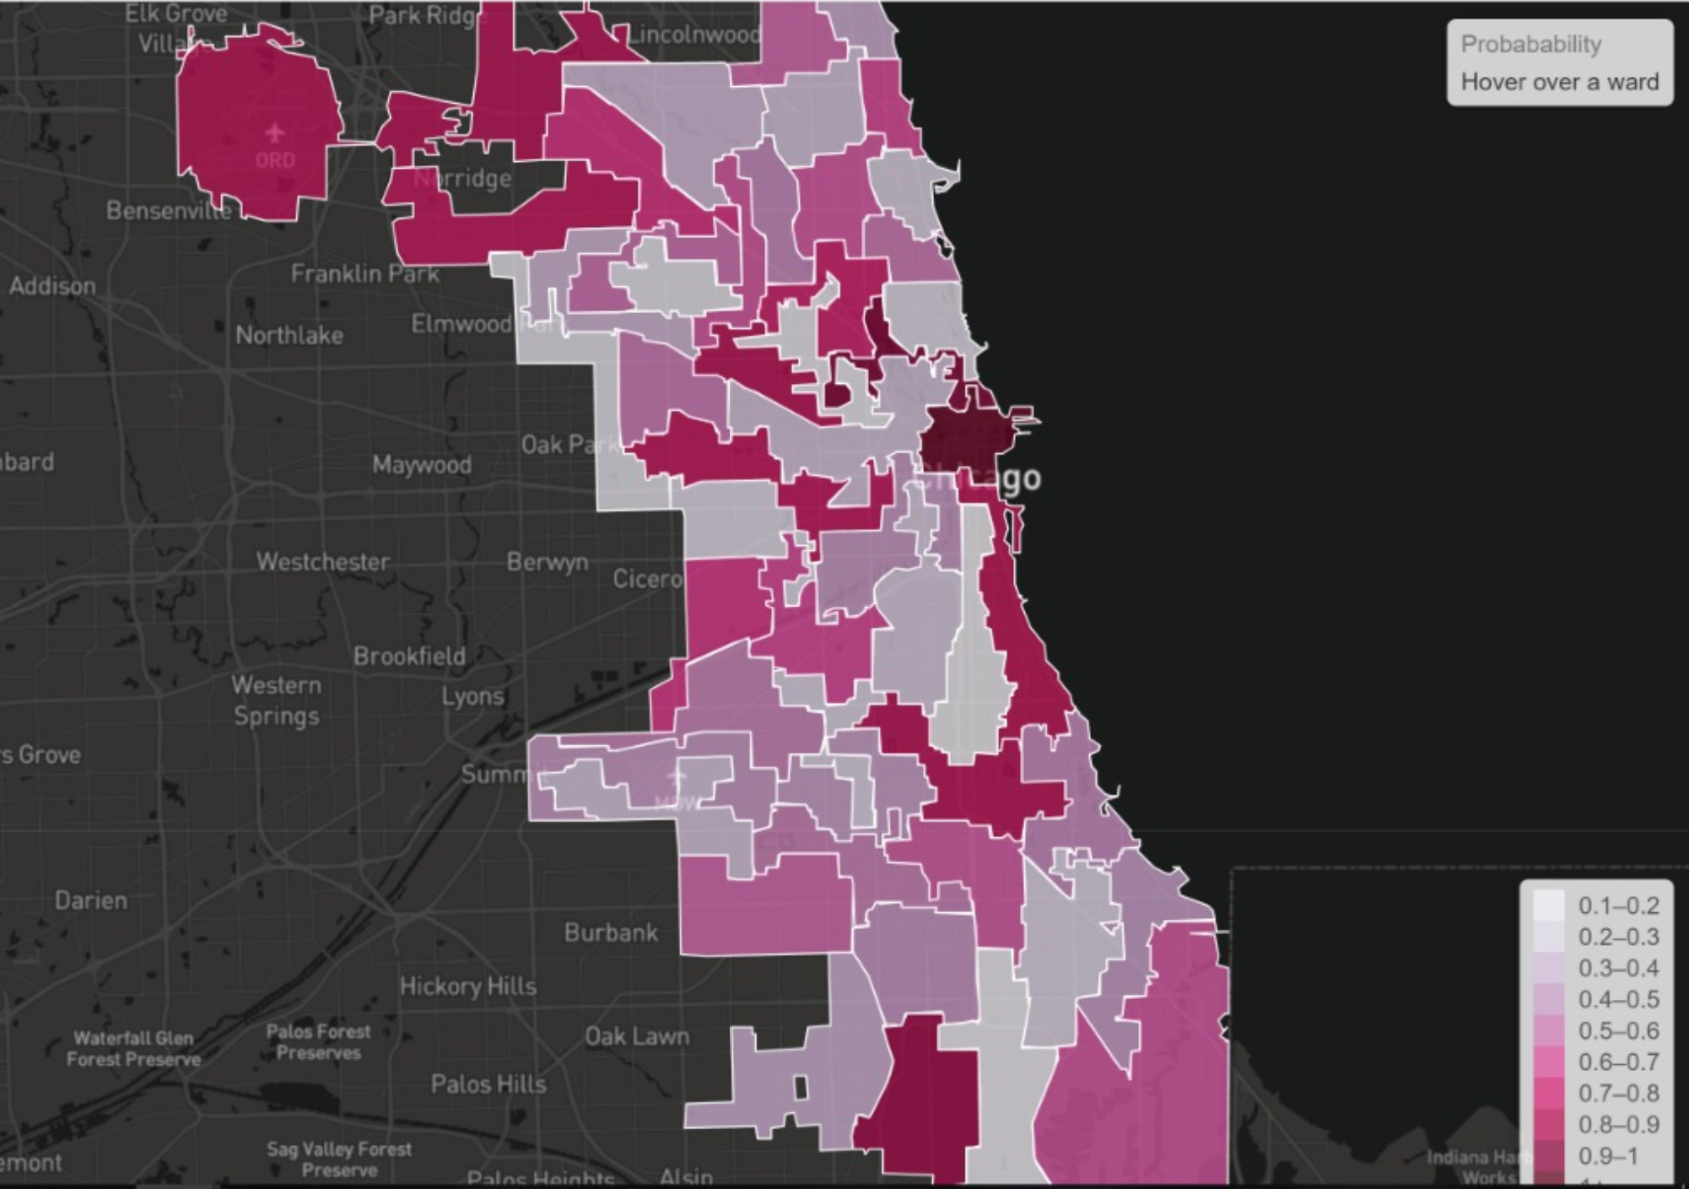
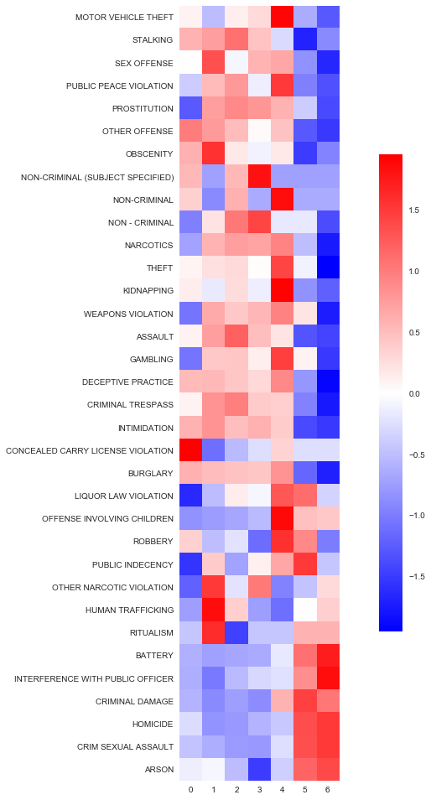
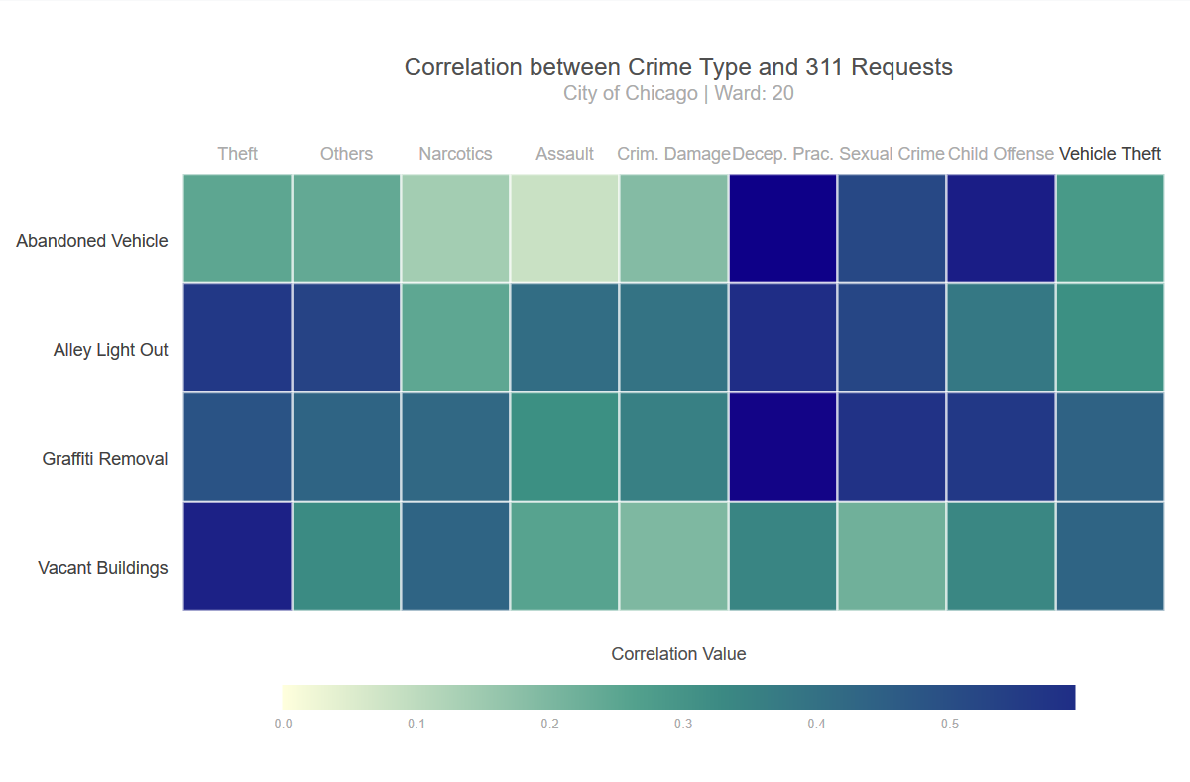
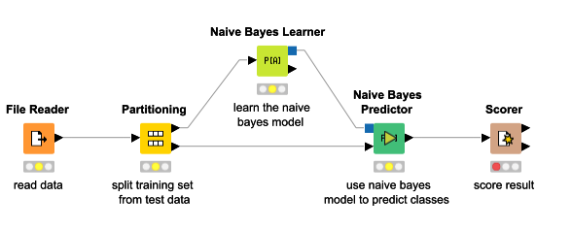
CrimeMapper: Forecasting Ward-level Crime Probabilities with “WHAT METHOD”
Kuhu Gupta, Preeti Maan and Vatsal Shrivastava Faculty Advisor: Polo Chau
Introduction
CrimeMapper is a web-based map application for predicting and exploring spatial-temporal patterns of different types of violent crimes and 311 requests in the City of Chicago. Utilizing this geo-visual analytic tool, analysts can uncover detailed spatio-temporal patterns of Chicago crimes at the ward level as well as the correlation of 311 requests, extending the value of the data served from the existing website (https://data.cityofchicago.org/).
The client-server application predicts the probability of crime incidents on a basemap using Mapbox Tile Layers with Leaflet.js with supporting visualization in d3.js. For prediction the user can choose by time, (i.e., date, month and year from the calendar filter and time from the clock filter) and attribute (i.e. type of crime).
Using our application, analysts can forecast the probability of occurrence of a certain type of crime at the ward level to support policy decisions for the reduction and prevention of such crimes.
Innovation
The general work in this area has not looked at the aspect of an area’s health in the crime mapping. It’s quite possible that an unlit street or alley gives rise to an assault or burglary, or the fact that an abandoned vehicle is more likely to be stolen or damaged. Our approach tried to explore these aspects of the problem as well.
We integrated our data with the 311 requests as well and found some interesting correlations between certain kinds of crimes and the 311 requests.
Historical Crime Data
Naïve Bayes Model
Visualization Interface
311 Requests (Abandoned vehicles, Graffiti,…)
Prediction
Results
Vacant/Abandoned Buildings
Database
Fig Our Approach
The above diagram shows the application flow of the Crime Mapper application starting from data source to application result visualization.
Experiments and Results
We have experimented with various type models Naïve Bayes, Decision Tree and Random Forest being among them, before settling on Naïve Bayes model for this problem.
We have explored the association between different categories of crime to week-day and time of the day, to find strong correlation which we have captured by some charts.
Crime by hour - Which types of crimes occur at which times of the day? We see a clear time phase distribution about when different kinds of crimes take place in the day.
Days and hours - Distribution of crimes over times and days. We can get some idea about the probable times of the different days when we should be more alert.
Crimes and day of week –
Which types of crimes occur
on which parts of the week?
We observe a clear demarcation
of crimes that happen on
weekdays vs those that
prominently happen over
weekends.
We also explored the interconnection between daily weather data and crime and found them to be weakly related with the crime probability and thus not adding much value to improve the predictions.
Data
The city of Chicago maintains a database of ward level data that includes a record of various crimes reported in the various parts of the city and 311 requests for reporting problems such as abandoned vehicles, graffiti, etc.
In our case study we used the Crime dataset from 2001-2017 and the 311 records for the same period.
Data cleaning - The crime cases from 2001 to 2004 were either not recorded or had missing attributes. So only the data from 2005 to 2016 was used.
The attributes we are using are- the day of the week, day of the year, time-slot corresponding to the police shift and hour of the day. There are more than 25 categories of crime. Since many of them had very few reported data instances (less than 20), the categories are mapped into 8 broad categories.
CrimeMapper Application View
The above figure shows the final application that renders ward level crime probabilities in the city of Chicago.
Dataset | Raw Dataset Size | Rows and Columns
Crime Dataset | 1.6GB | 6 million rows and 23 columns
311 records | 440MB | 1.5 million rows and 22 columns
View of Narcotics Crime Probabilities
Show the respective chance of occurrence of narcotics crime in every ward indicated using color saturation.
Approach
We experimented with Gaussian Naive Bayes, Decision Tree and Random Forest Classifiers. The output of the program is a ward level probability for the various crimes.
The reason we started with a simple Naive Bayes approach is to get an idea about the base level performance. The assumption of independence between the features also seems relevant. We then experimented with a Random Forest based model to improve upon our accuracy.
Visual Display
A Choropleth Map— A choropleth map is a thematic map in which areas are shaded or patterned in proportion to the measurement of the statistical variable being displayed on the map, such as crime probability in this scenario.
It provides an easy way to visualize how a probability varies across the wards of Chicago using color saturation. Implementing a custom designed map by Mapbox using Leaflet.js Library, users can access a ward and street level perspective of crime occurrences. Employing the principles of “Overview first, zoom and filter, then details on demand”.
Heat Map – A heat map is a graphical representation of data where the individual values contained in a matrix are represented as colors. In this scenario, Heatmap is used to represent correlation between different types of 311 requests and crime types in each ward.
View of Assault Probabilities
Show the respective chance of occurrence of assault in every ward indicated using color saturation.
References
[1] Almanie, T., Mirza, R. and Lor, E. (2015). Crime Prediction Based on Crime Types and Using Spatial and Temporal Criminal Hotspots. International Journal of Data Mining & Knowledge Management Process, 5(4), pp.01-19.
[2] Oatley, G.C., Zeleznikow, J., and Ewart, B.W., (2004), Matching and Predicting Crimes. In: Macintosh,. A, Ellis, R. and Allen, T. (eds.), Applications and Innovations in Intelligent Systems XII. Proceedings of AI2004, The Twenty-fourth SGAI International Conference on Knowledge-Based Systems and Applications of Artificial Intelligence, Springer: 19-32. ISBN 1-85233-908-X
[3] Johnson, S.H. and Bowers, K.J. (2004) The Burglary as Clue to the Future: The Beginnings of Prospective Hot-Spotting, European Journal of Criminology, Vol 1 (2): 237-255: 1477-3708.
Heatmap of Crime Type and 311 Requests
The above figure depicts the correlation between crime probabilities and 311 requests for different crime and request type.

Slide 2
CrimeMapper: Forecasting Ward-level Crime Probabilities with “WHAT METHOD”
Kuhu Gupta, Preeti Maan and Vatsal Shrivastava Faculty Advisor: Polo Chau
Introduction
CrimeMapper is a web-based map application for predicting and exploring spatial-temporal patterns of different types of violent crimes and 311 requests in the City of Chicago. Utilizing this geo-visual analytic tool, analysts can uncover detailed spatio-temporal patterns of Chicago crimes at the ward level as well as the correlation of 311 requests, extending the value of the data served from the existing website (https://data.cityofchicago.org/).
The client-server application predicts the probability of crime incidents on a basemap using Mapbox Tile Layers with Leaflet.js with supporting visualization in d3.js. For prediction the user can choose by time, (i.e., date, month and year from the calendar filter and time from the clock filter) and attribute (i.e. type of crime).
Using our application, analysts can forecast the probability of occurrence of a certain type of crime at the ward level to support policy decisions for the reduction and prevention of such crimes.
Innovation
The general work in this area has not looked at the aspect of an area’s health in the crime mapping. It’s quite possible that an unlit street or alley gives rise to an assault or burglary, or the fact that an abandoned vehicle is more likely to be stolen or damaged. Our approach tried to explore these aspects of the problem as well.
We integrated our data with the 311 requests as well and found some interesting correlations between certain kinds of crimes and the 311 requests.
Historical Crime Data
Naïve Bayes Model
Visualization Interface
311 Requests (Abandoned vehicles, Graffiti,…)
Prediction
Results
Vacant/Abandoned Buildings
Database
Fig Our Approach
The above diagram shows the application flow of the Crime Mapper application starting from data source to application result visualization.
Experiments and Results
We have experimented with various type models Naïve Bayes, Decision Tree and Random Forest being among them, before settling on Naïve Bayes model for this problem.
We have explored the association between different categories of crime to week-day and time of the day, to find strong correlation which we have captured by some charts.
Crime by hour - Which types of crimes occur at which times of the day? We see a clear time phase distribution about when different kinds of crimes take place in the day.
Days and hours - Distribution of crimes over times and days. We can get some idea about the probable times of the different days when we should be more alert.
Crimes and day of week –
Which types of crimes occur
on which parts of the week?
We observe a clear demarcation
of crimes that happen on
weekdays vs those that
prominently happen over
weekends.
We also explored the interconnection between daily weather data and crime and found them to be weakly related with the crime probability and thus not adding much value to improve the predictions.
Data
The city of Chicago maintains a database of ward level data that includes a record of various crimes reported in the various parts of the city and 311 requests for reporting problems such as abandoned vehicles, graffiti, etc.
In our case study we used the Crime dataset from 2001-2017 and the 311 records for the same period.
Data cleaning - The crime cases from 2001 to 2004 were either not recorded or had missing attributes. So only the data from 2005 to 2016 was used.
The attributes we are using are- the day of the week, day of the year, time-slot corresponding to the police shift and hour of the day. There are more than 25 categories of crime. Since many of them had very few reported data instances (less than 20), the categories are mapped into 8 broad categories.
CrimeMapper Application View
The above figure shows the final application that renders ward level crime probabilities in the city of Chicago.
Dataset | Raw Dataset Size | Rows and Columns
Crime Dataset | 1.6GB | 6 million rows and 23 columns
311 records | 440MB | 1.5 million rows and 22 columns
View of Narcotics Crime Probabilities
Show the respective chance of occurrence of narcotics crime in every ward indicated using color saturation.
Approach
We experimented with Gaussian Naive Bayes, Decision Tree and Random Forest Classifiers. The output of the program is a ward level probability for the various crimes.
The reason we started with a simple Naive Bayes approach is to get an idea about the base level performance. The assumption of independence between the features also seems relevant. We then experimented with a Random Forest based model to improve upon our accuracy.
Visual Display
A Choropleth Map— A choropleth map is a thematic map in which areas are shaded or patterned in proportion to the measurement of the statistical variable being displayed on the map, such as crime probability in this scenario.
It provides an easy way to visualize how a probability varies across the wards of Chicago using color saturation. Implementing a custom designed map by Mapbox using Leaflet.js Library, users can access a ward and street level perspective of crime occurrences. Employing the principles of “Overview first, zoom and filter, then details on demand”.
Heat Map – A heat map is a graphical representation of data where the individual values contained in a matrix are represented as colors. In this scenario, Heatmap is used to represent correlation between different types of 311 requests and crime types in each ward.
View of Assault Probabilities
Show the respective chance of occurrence of assault in every ward indicated using color saturation.
References
[1] Almanie, T., Mirza, R. and Lor, E. (2015). Crime Prediction Based on Crime Types and Using Spatial and Temporal Criminal Hotspots. International Journal of Data Mining & Knowledge Management Process, 5(4), pp.01-19.
[2] Oatley, G.C., Zeleznikow, J., and Ewart, B.W., (2004), Matching and Predicting Crimes. In: Macintosh,. A, Ellis, R. and Allen, T. (eds.), Applications and Innovations in Intelligent Systems XII. Proceedings of AI2004, The Twenty-fourth SGAI International Conference on Knowledge-Based Systems and Applications of Artificial Intelligence, Springer: 19-32. ISBN 1-85233-908-X
[3] Johnson, S.H. and Bowers, K.J. (2004) The Burglary as Clue to the Future: The Beginnings of Prospective Hot-Spotting, European Journal of Criminology, Vol 1 (2): 237-255: 1477-3708.
Heatmap of Crime Type and 311 Requests
The above figure depicts the correlation between crime probabilities and 311 requests for different crime and request type.

